Slide 1


Mobile App

Slide 2

The problem
PATH riders have no easy way to check schedules or receive real-time service alerts on their phones.
?

Slide 3
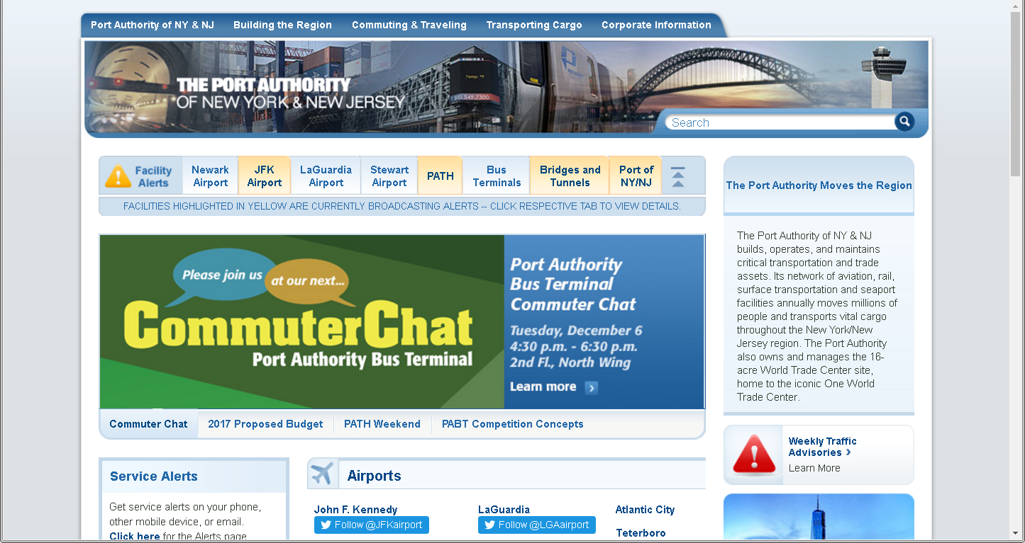
The problem
Desktop-only site is difficult to navigate on mobile, with schedules nearly impossible to find.

Slide 4
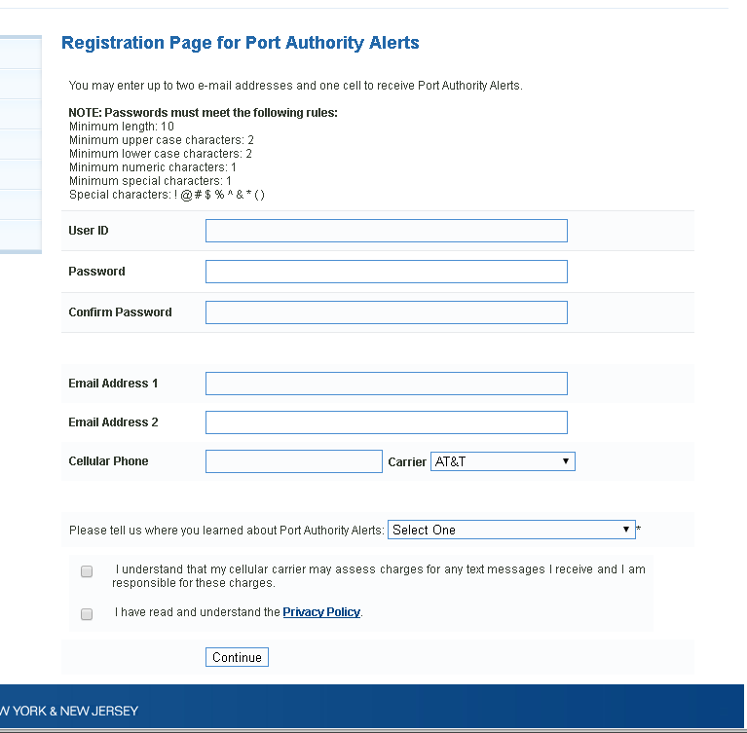
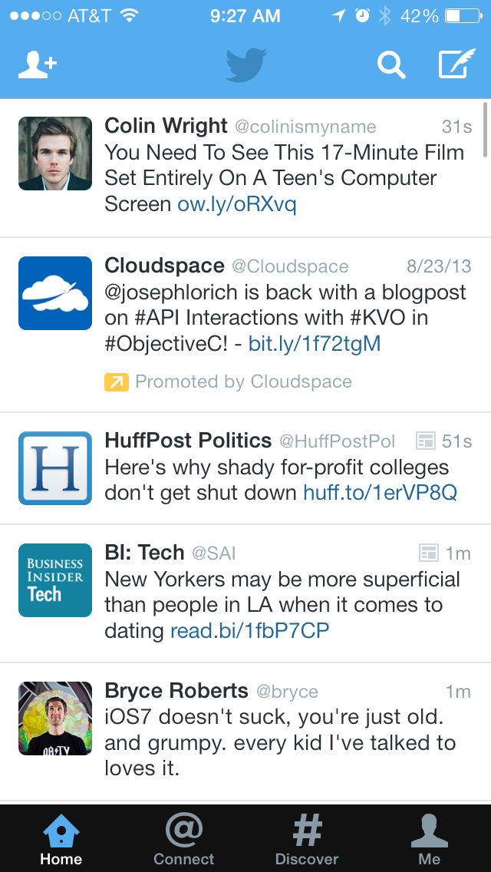
The problem
Need to dig through a lot of tweets to find PATH Alerts on your Twitter feed...
Or fill out a long form to receive text alerts, which are often arrive too late.

Slide 5

The solution
An official mobile app for the PATH, to put all this information in one fast, easy-to-access place.

Slide 6
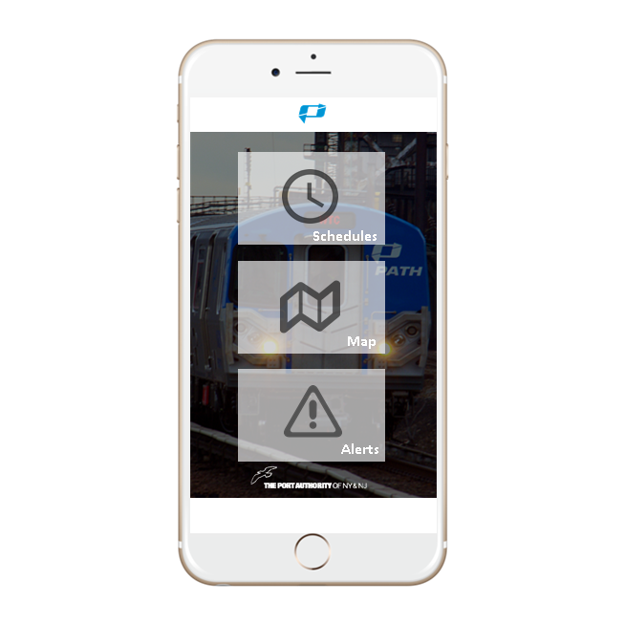
The Solution
SCHEDULES
Pick a route and view timetables based on day
MAP
View a map of the entire PATH system
ALERTS
View a feed of real time service alerts

Slide 7

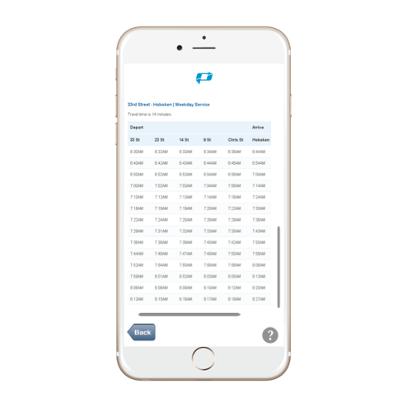
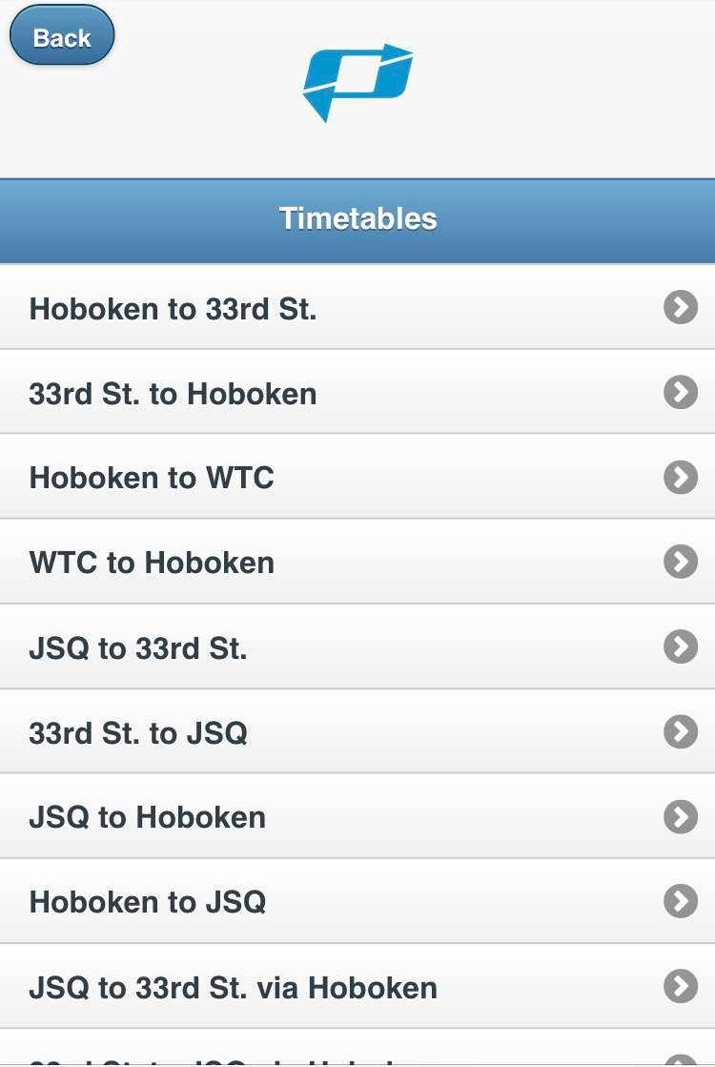
Get timetables for all routes, based on day and time.

Slide 8
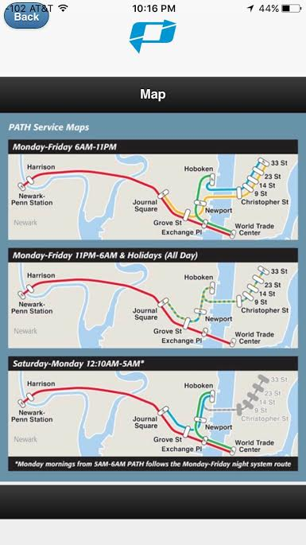
View system map with the click of a button.

Slide 9
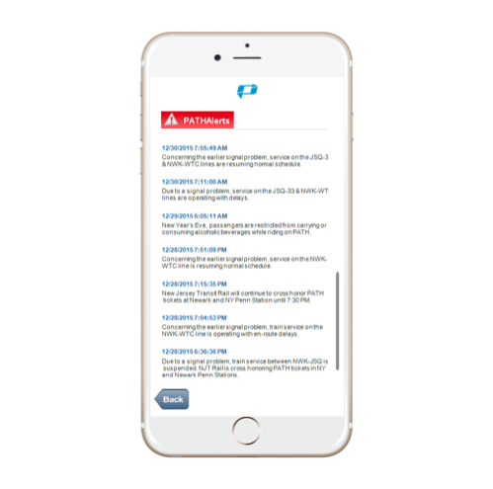
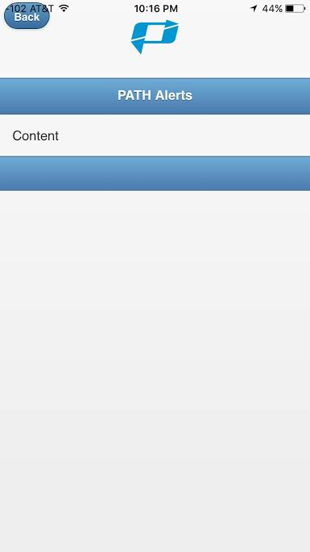
One-touch access to PATH’s real-time alerts feed.

Slide 10
Market Analysis
PATH’s annual ride volume, as of 2016, is approximately 100 million, and is projected to grow.
Smartphones make up 79.3% of the mobile phone market.
25% use their phone at least occasionally to get public transit information, with 10% doing this “frequently.”*
*http://www.pewinternet.org/2015/04/01/us-smartphone-use-in-2015/

Slide 11

Target Market
Average PATH ridership during peak commuting hours is 100,000 (morning and night), with daily ridership at 278,000
COMMUTERS

Slide 12
Value Proposition
Provide real time alerts, schedules, and map in an all-in-one, easy-to-access mobile app
No other 3rd party app can offer real time alerts, since they cannot access the PA’s official RSS feed - we can.
Allows PATH to consolidate communications into one channel, to remove redundancy, improve efficiency, and thus reduce cost

Slide 13
Revenue Model
Partner with xAd, or a similar location-based advertising company, who can generate CPM of $30 on average.
Assuming 10% of PATH’s 100 million annual riders sign up in the first year, annual ad revenues will start at $200,000, growing to $1.8 million by 2020 with adoption growth.
The PATH app will initially earn revenue through advertising.

Slide 14
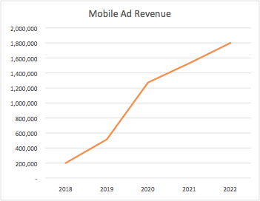
Revenue Model
The PATH app will initially earn revenue through advertising.

Slide 15
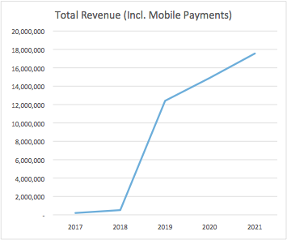
Revenue Model
If the Port Authority successfully layers on mobile payments, yields on fare collections increase by a minimum of $.16 a sale, based on a prior study.
Incremental revenues of $14 million by 2019, assuming 50% adoption.

Slide 16
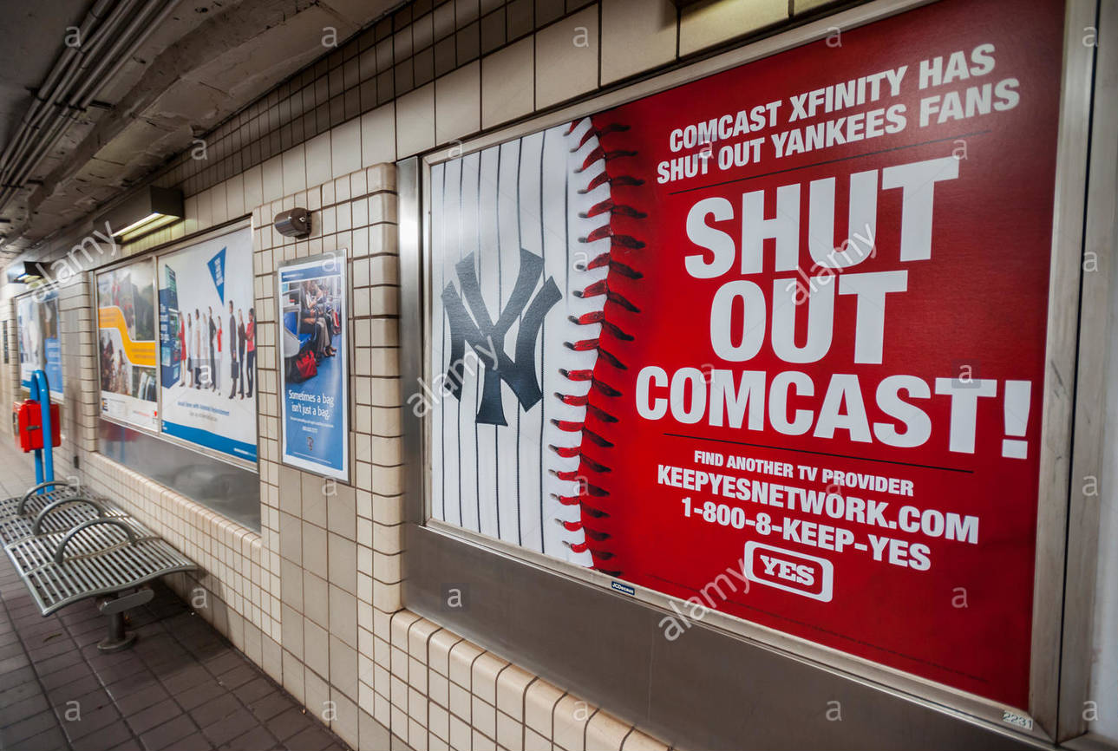
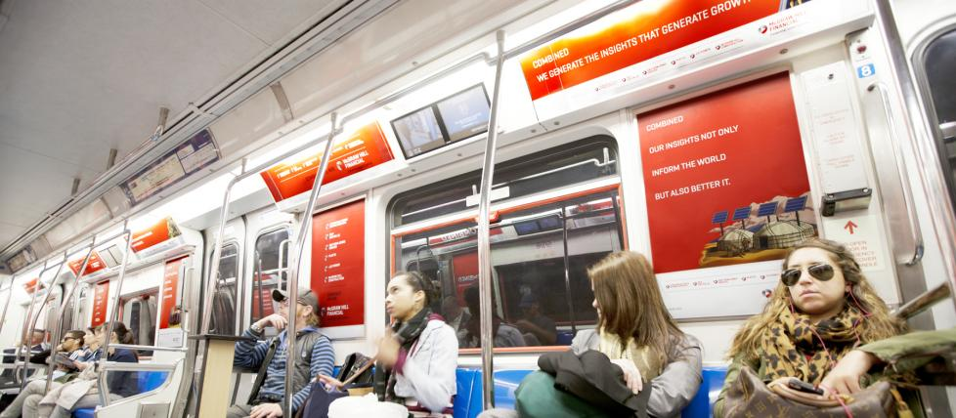
Launch Strategy
Station Posters
The Port Authority can advertise throughout its own stations and train cars for free, via its contract with JCDecaux.
Train Posters

Slide 17
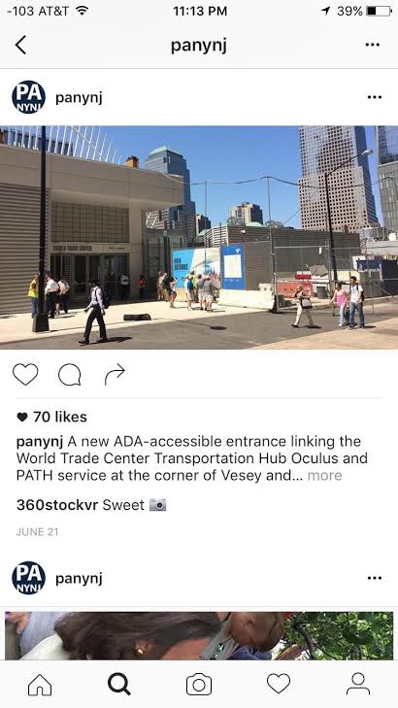
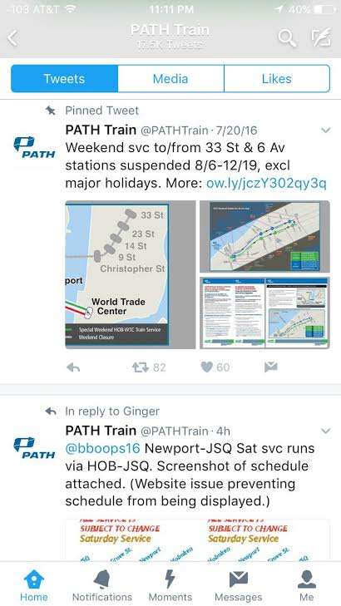


Launch Strategy
Social media will also play a part in getting the word out.

Slide 18
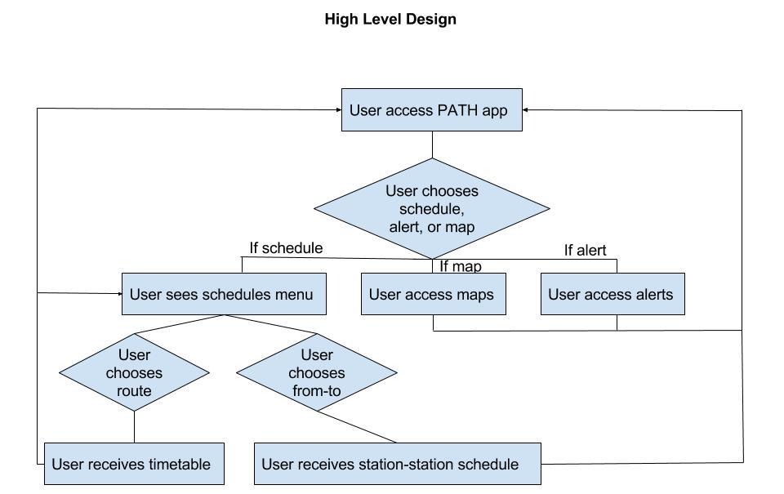
High Level Design
Data
..._
_...
_...
_...
_...
_...

Slide 19


Technical Approach & Methodology
Development Tools
Front End
DW jQuery Mobile web pages to create local website
PhoneGap Developer to connect the desktop and mobile device to preview the application

Slide 20
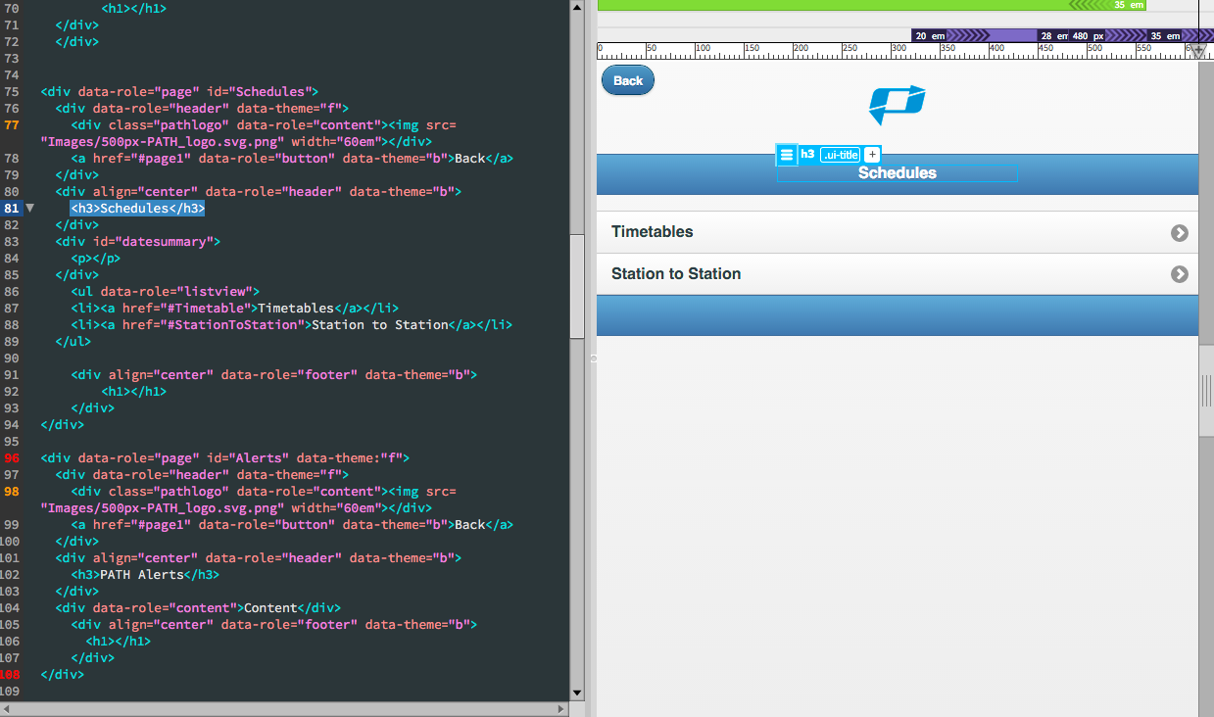
Technical Approach & Methodology
jQuery Mobile - Elements
Front End

Slide 21
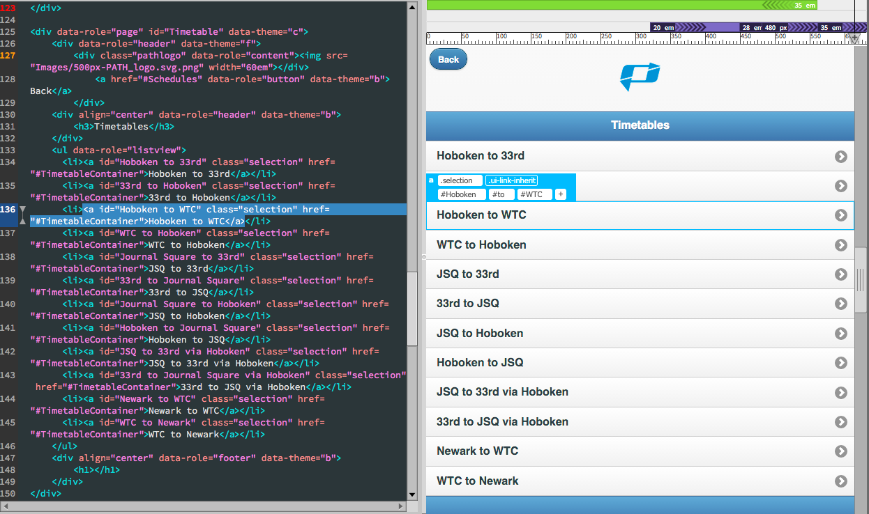
Technical Approach & Methodology
jQuery Mobile - Listview
Front End

Slide 22
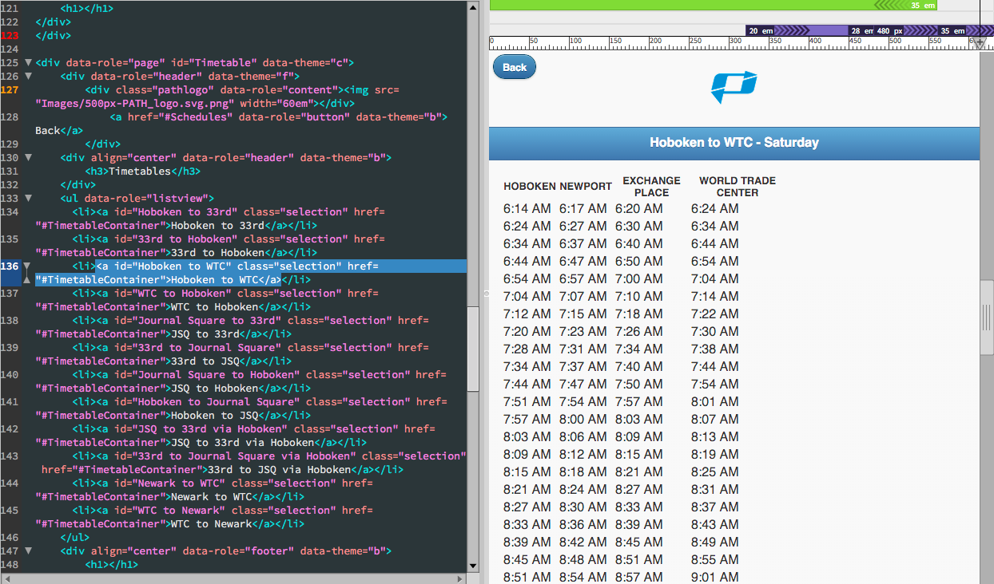
Technical Approach & Methodology
jQuery Mobile - Listview
Front End

Slide 23
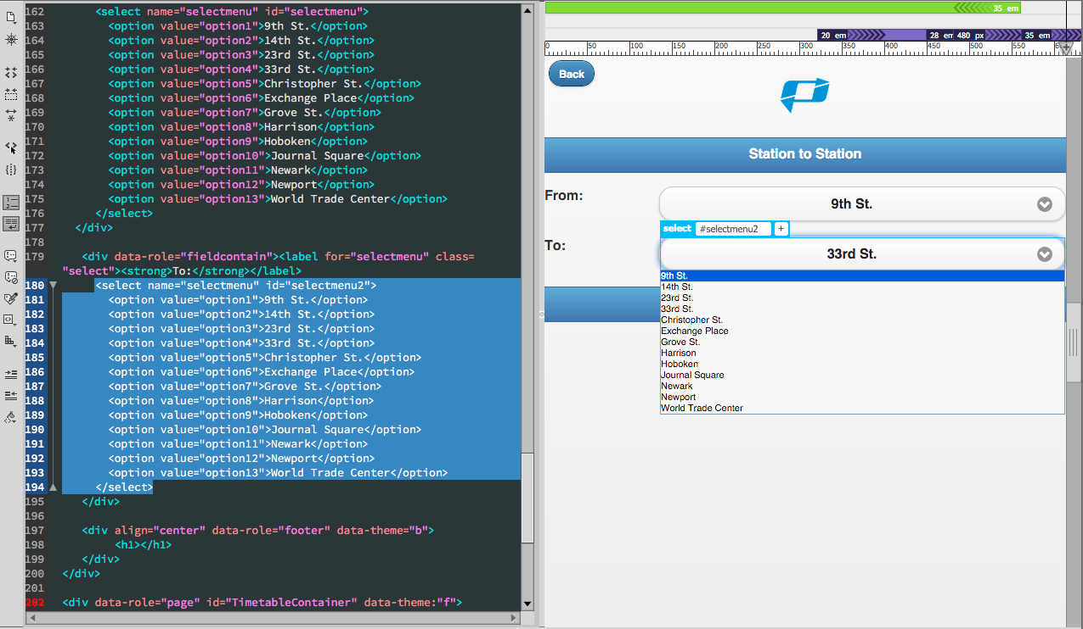
Technical Approach & Methodology
jQuery Mobile - Select menu
Front End

Slide 24

Technical Approach & Methodology
Development Tools
Back End
Server Side
Client Side
Server
NodeJS
MongoDB
File
Port

Slide 25
Fetching The Data On The Client
Server and Client Communication
We have Node server running on backend which is responsible for serving the data based on the client request.
Server follows REST API Concepts. It has few GET routes.
Client makes Ajax call when user opens the App.
Server fetches the data from MongoDB and gives that to client as a JSON object.
Client parses the data, stores it locally and uses it to show timetables for different possible routes.

Slide 26
Fetching The Data On The Client
Server and Client Communication
Following Diagram illustrates Client/Server Communication Flow
GET request from client
Server
Response: JSON Data

Slide 27
Fetching The Data On The Client
Server and Client Communication
To show the alerts on the client data flow is bit different.
Whenever client makes request to fetch the alerts, server in turn fetches fresh RSS feeds from PATH website.
Server parses the data which was in XML format and converts it into JSON format.
Server then sends that JSON object to client.
Client displays alerts.

Slide 28
Problems Encountered
Schedule data did not come in a useable form. We needed to clean the data and reformat it to make it easier to query.
In trying to include some of the logic on the the client side, we realized there would be some difficulty in integrating with PhoneGap. For this reason, we had to move the logic to the server side.
Example: fetching alert data from the PATH RSS feed and parsing the XML using Node modules introduced complications when running Node with PhoneGap.
We realized that users would not be able to fetch schedule data when underground. For this reason, we explored saving the data locally on the user’s device when internet service is available.

Slide 29
Next Steps
Station-to-Station scheduling, including instructions on transferring
Incorporate advertising
Layer in mobile ticket purchase and contactless payments
Push notifications for alerts

Slide 30
THANK YOU

